Slide 1
Advanced Relational Algebra and SQL JOIN Expressions

Slide 2
Outline
Join Expressions
Notes:
1
Join Expressions – se pripojuiva so prethodna lekcija I taka se deli na dve predavanja so sto se pokriva so stari ppt
Ostatokot se spojuva so triggers od naredna I se dobivaat 2 predavanja
In this chapter, we continue our study of SQL. We consider more complex forms of SQL queries, view definition, transactions, integrity constraints, more details regarding SQL data definition, and authorization.

Slide 3
Joined Relations
Join operations take two relations and return as a result another relation.
A join operation is a Cartesian product which requires that tuples in the two relations match (under some condition). It also specifies the attributes that are present in the result of the join
The join operations are typically used as subquery expressions in the from clause
Three types of joins:
Natural join
Inner join
Outer join
Notes:
In all of the example queries we used in Chapter 3 (except when we used set operations), we combined information from multiple relations using the Cartesian product operator. In this section, we introduce a number of “join” operations that allow the programmer to write some queries in a more natural way and to express some queries that are difficult to do with only the Cartesian product.

Slide 4
Natural Join in SQL
Natural join matches tuples with the same values for all common attributes, and retains only one copy of each common column.
List the names of instructors along with the course ID of the courses that they taught
select name, course_id from students, takes where student.ID = takes.ID;
Same query in SQL with “natural join” construct
select name, course_id from student natural join takes;
Notes:
Consider the following SQL query, which computes for each student the set of courses a student has taken:
Note that this query outputs only students who have taken some course. Students who have not taken any course are not output.
Note that in the student and takes table, the matching condition required student.ID to be equal to takes.ID. These are the only attributes in the two relations that have the same name. In fact, this is a common case; that is, the matching condition in the from clause most often requires all attributes with matching names to be equated.
To make the life of an SQL programmer easier for this common case, SQL supports an operation called the natural join, which we describe below. In fact, SQL supports several other ways in which information from two or more relations can be joined together. We have already seen how a Cartesian product along with a where clause predicate can be used to join information from multiple relations. Other ways of joining information from multiple relations are discussed in Section 4.1.2 through Section 4.1.4.
The natural join operation operates on two relations and produces a relation as the result. Unlike the Cartesian product of two relations, which concatenates each tuple of the first relation with every tuple of the second, natural join considers only those pairs of tuples with the same value on those attributes that appear in the schemas of both relations. So, going back to the example of the relations student and takes, computing:
student natural join takes
considers only those pairs of tuples where both the tuple from student and the tuple from takes have the same value on the common attribute, ID.

Slide 5
Natural Join in SQL (Cont.)
The from clause can have multiple relations combined using natural join:
select A₁, A₂, … A_{n} from r₁ natural join r₂ natural join .. natural join r_{n} where P ;
Notes:
The result of the natural join operation is a relation. Conceptually, expression “student natural join takes” in the from clause is replaced by the relation obtained by evaluating the natural join. The where and select clauses are then evaluated on this relation, as we saw in Section 3.3.2.
A from clause in an SQL query can have multiple relations combined using natural join, as shown here:
select A1, A2, …, An
from r₁ natural join r₂ natural join ... natural join r_{m}
where P;

Slide 6
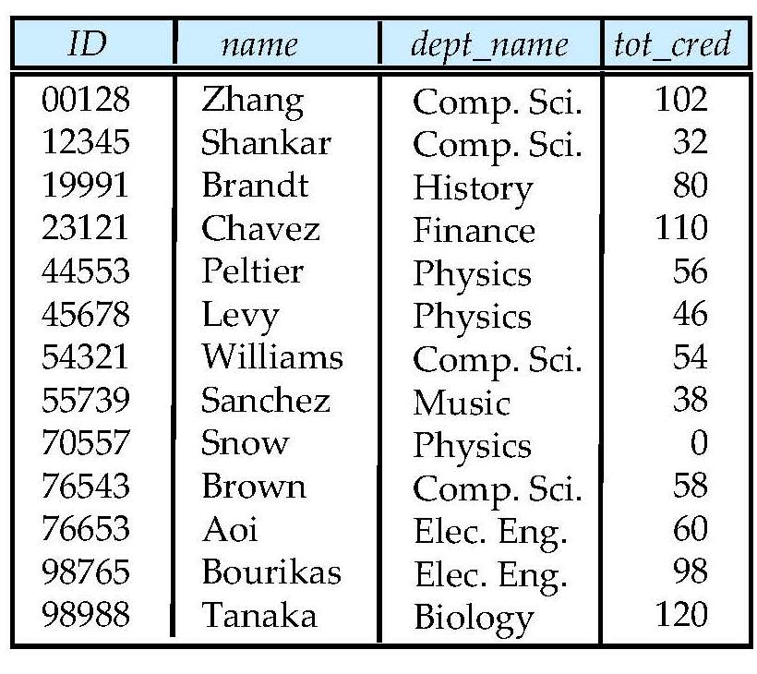
Student Relation

Slide 7
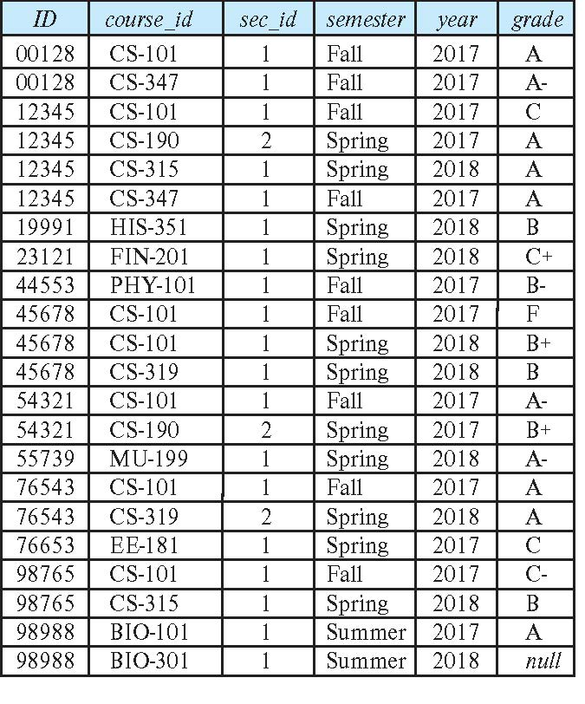
Takes Relation

Slide 8
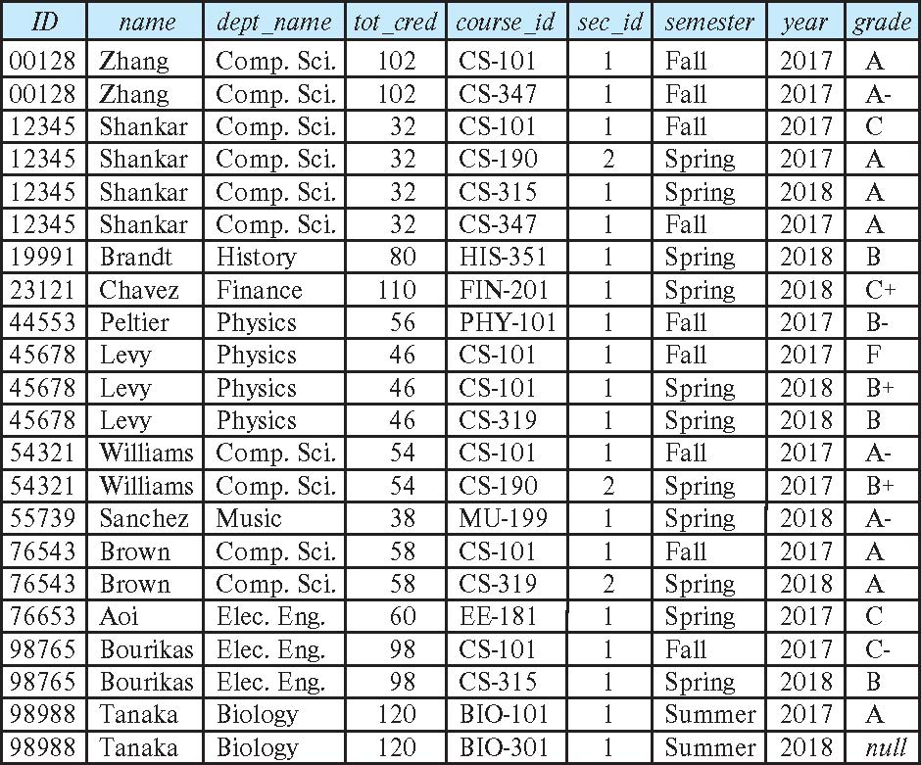
student natural join takes

Slide 9
Dangerous in Natural Join
Beware of unrelated attributes with same name which get equated incorrectly
Example -- List the names of students instructors along with the titles of courses that they have taken
Correct version
select name, title from student natural join takes, course where takes.course_id = course.course_id;
Incorrect version
select name, title from student natural join takes natural join course;
This query omits all (student name, course title) pairs where the student takes a course in a department other than the student's own department.
The correct version (above), correctly outputs such pairs.
Notes:
More generally, a from clause can be of the form
from E₁, E₂,..., E_{n}
where each E_{i} can be a single relation or an expression involving natural joins. For example, suppose we wish to answer the query “List the names of students along with the titles of courses that they have taken.” The query can be written in SQL as follows:
The natural join of student and takes is first computed, as we saw earlier, and a Cartesian product of this result with course is computed, from which the where clause extracts only those tuples where the course identifier from the join result matches the course identifier from the course relation. Note that takes.course_id in the where clause refers to the course_id field of the natural join result, since this field, in turn, came from the takes relation
In contrast, the following SQL query does not compute the same result:
To see why, note that the natural join of student and takes contains the attributes (ID, name, dept_name, tot_cred, course_id, sec_id), while the course relation contains the attributes (course_id, title, dept_name, credits). As a result, the natural join would require that the dept_name attribute values from the two relations be the same in addition to requiring that the course_id values be the same. This query would then omit all (student name, course title) pairs where the student takes a course in a department other than the student’s own department. The previous query, on the other hand, correctly outputs such pairs.

Slide 10
Natural Join with Using Clause
To avoid the danger of equating attributes erroneously, we can use the “using” construct that allows us to specify exactly which columns should be equated.
Query example
select name, title from (student natural join takes) join course using (course_id)
The operation is similar to r₁ natural join r₂, except that a pair of tuples t₁ from r₁ and t₂ from r₂ match if t₁.A₁ = t₂.A₁ and t₁.A₂ = t₂.A₂; even if r₁ and r₂ both have an attribute named A₃, it is not required that t₁.A₃ = t₂.A₃.
Notes:
To provide the benefit of natural join while avoiding the danger of equating attributes erroneously, SQL provides a form of the natural join construct that allows you to specify exactly which columns should be equated. This feature is illustrated by the following query:
select name, title
from (student natural join takes) join course using (course id);
The operation join … using requires a list of attribute names to be specified. Both relations being joined must have attributes with the specified names.
Consider the operation r₁ join r₂ using(A₁, A₂). The operation is similar to r₁ natural join r₂, except that a pair of tuples t₁ from r₁ and t₂ from r₂ match if t₁.A₁ = t₂.A₁ and t₁.A₂ = t₂.A₂; even if r₁ and r₂ both have an attribute named A₃, it is not required that t₁.A₃ = t₂.A₃.
Ne mora

Slide 11
Join Condition
The on condition allows a general predicate over the relations being joined
This predicate is written like a where clause predicate except for the use of the keyword on
Query example
select * from student join takes on student_ID = takes_ID
The on condition above specifies that a tuple from student matches a tuple from takes if their ID values are equal.
Equivalent to:
select * from student , takes where student_ID = takes_ID
Notes:
In Section 4.1.1, we saw how to express natural joins, and we saw the join … using clause, which is a form of natural join that requires values to match only on specified attributes. SQL supports another form of join, in which an arbitrary join condition can be specified.
The on condition allows a general predicate over the relations being joined. This predicate is written like a where clause predicate except for the use of the keyword on rather than where. Like the using condition, the on condition appears at the end of the join expression.
Consider the following query, which has a join expression containing the on condition:
select * from student join takes on student_ID = takes_ID
The on condition above specifies that a tuple from student matches a tuple from takes if their ID values are equal. The join expression in this case is almost the same as the join expression student natural join takes, since the natural join operation also requires that for a student tuple and a takes tuple to match. The one difference is that the result has the ID attribute listed twice, in the join result, once for student and once for takes, even though their ID values must be the same.
In fact, the preceding query is equivalent to the following query:
select * from student , takes where student_ID = takes_ID

Slide 12
Join Condition (Cont.)
Query example- earlier
select student.ID as ID, name, dept_name, tot_cred,
course_id, sec_id, semester, year, grade
from student join takes on student.ID = takes.ID;
Equivalent to:
select * from student , takes where student_ID = takes_ID
two good reasons for introducing the on condition
First, we shall see shortly that for a kind of join called an outer join, on conditions do behave in a manner different from where conditions.
Second, an SQL query is often more readable by humans if the join condition is specified in the on clause and the rest of the conditions appear in the where clause.
Notes:
Da se smeni tekstot od slajdot dupli e
As we have seen earlier, the relation name is used to disambiguate the attribute name ID, and thus the two occurrences can be referred to as student.ID and takes.ID, respectively. A version of this query that displays the ID value only once is as follows:
select student.ID as ID, name, dept_name, tot_cred,
course_id, sec_id, semester, year, grade
from student join takes on student.ID = takes.ID;
The result of this query is exactly the same as the result of the natural join of student and takes, which we showed in Figure 4.3.
The on condition can express any SQL predicate, and thus join expressions using the on condition can express a richer class of join conditions than natural join. However, as illustrated by our preceding example, a query using a join expression with an on condition can be replaced by an equivalent expression without the on condition, with the predicate in the on clause moved to the where clause. Thus, it may appear that the on condition is a redundant feature of SQL.
However, there are two good reasons for introducing the on condition.
First, we shall see shortly that for a kind of join called an outer join, on conditions do behave in a manner different from where conditions. Second, an SQL query is often more readable by humans if the join condition is specified in the on clause and the rest of the conditions appear in the where clause.
Ne mora

Slide 13
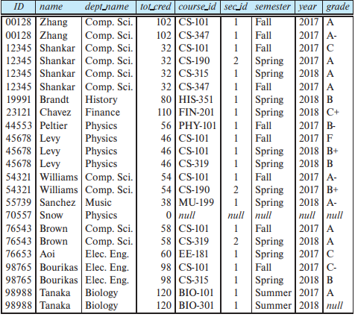
Outer Join
An extension of the join operation that avoids loss of information.
Computes the join and then adds tuples form one relation that does not match tuples in the other relation to the result of the join.
Uses null values.
Three forms of outer join:
left outer join
right outer join
full outer join
Notes:
Suppose we wish to display a list of all students, displaying their ID, and name, dept_name, and tot_cred, along with the courses that they have taken. The following SQL query may appear to retrieve the required information:
select *
from student natural join takes;
Unfortunately, the above query does not work quite as intended. Suppose that there is some student who takes no courses. Then the tuple in the student relation for that particular student would not satisfy the condition of a natural join with any tuple in the takes relation, and that student’s data would not appear in the result. We would thus not see any information about students who have not taken any courses. For example, in the student and takes relations of Figure 4.1 and Figure 4.2, note that student Snow, with ID 70557, has not taken any courses. Snow appears in student, but Snow’s ID number does not appear in the ID column of takes. Thus, Snow does not appear in the result of the natural join.
Snow Philips
More generally, some tuples in either or both of the relations being joined may be “lost” in this way. The outer-join operation works in a manner similar to the join operations we have already studied, but it preserves those tuples that would be lost in a join by creating tuples in the result containing null values.
For example, to ensure that the student named Snow from our earlier example appears in the result, a tuple could be added to the join result with all attributes from the student relation set to the corresponding values for the student Snow, and all the remaining attributes which come from the takes relation, namely, course_id, sec_id, semester, and year, set to null. Thus, the tuple for the student Snow is preserved in the result of the outer join.
There are three forms of outer join:
The left outer join preserves tuples only in the relation named before (to the left of) the left outer join operation.
The right outer join preserves tuples only in the relation named after (to the right of) the right outer join operation.
The full outer join preserves tuples in both relations.

Slide 14
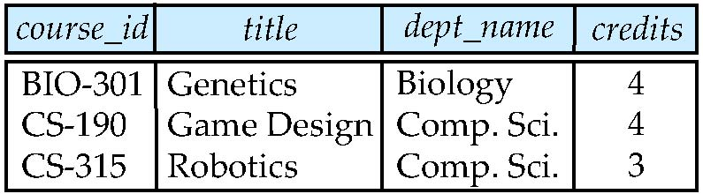
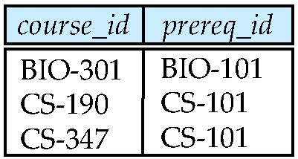
Outer Join Examples
Relation course
Relation prereq
Observe that
course information is missing CS-437
prereq information is missing CS-315
x

Slide 15
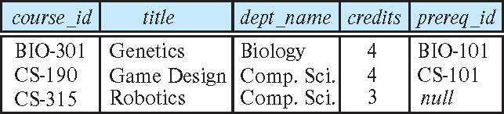
Left Outer Join
course natural left outer join prereq
In relational algebra: course ⟕ prereq
student natural left outer join takes →
Notes:
We now explain exactly how each form of outer join operates. We can compute the left outer-join operation as follows: First, compute the result of the inner join as before. Then, for every tuple t in the left-hand-side relation that does not match any tuple in the right-hand-side relation in the inner join, add a tuple r to the result of the join constructed as follows:
• The attributes of tuple r that are derived from the left-hand-side relation are filled in with the values from tuple t.
• The remaining attributes of r are filled with null values.
That result includes student Snow (ID 70557), unlike the result of an inner join, but the tuple for Snow includes nulls for the attributes that appear only in the schema of the takes relation.
(da se smeni samo ID….)

Slide 16
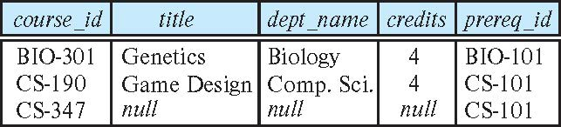
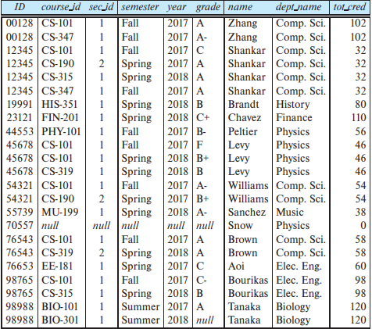
Right Outer Join
course natural right outer join prereq
In relational algebra: course ⟖ prereq
takes natural right outer join student →
Notes:
The right outer join is symmetric to the left outer join. Tuples from the right-handside relation that do not match any tuple in the left-hand-side relation are padded with nulls and are added to the result of the right outer join. Thus, if we rewrite the preceding query using a right outer join and swapping the order in which we list the relations as follows:
we get the same result except for the order in which the attributes appear in the result (see Figure 4.5).

Slide 17
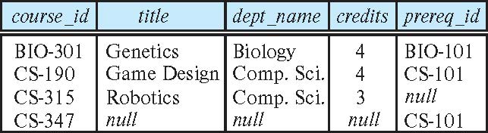
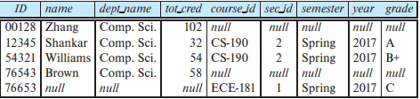
Full Outer Join
course natural full outer join prereq
In relational algebra: course ⟗ prereq
select *
from (select *
from student
where dept_name = 'Comp. Sci.')
natural full outer join
(select *
from takes
where semester = 'Spring' and year = 2017);
full outer join example →
Notes:
The full outer join is a combination of the left and right outer-join types. After the operation computes the result of the inner join, it extends with nulls those tuples from the left-hand-side relation that did not match with any from the right-hand-side relation and adds them to the result. Similarly, it extends with nulls those tuples from the right hand-side relation that did not match with any tuples from the left-hand-side relation and adds them to the result. Said differently, full outer join is the union of a left outer join and the corresponding right outer join.
As an example of the use of full outer join, consider the following query: “Display a list of all students in the Comp. Sci. department, along with the course sections, if any, that they have taken in Spring 2017; all course sections from Spring 2017 must be displayed, even if no student from the Comp. Sci. department has taken the course section.” This query can be written as:
select *
from (select *
from student
where dept_name = 'Comp. Sci.')
natural full outer join
(select *
from takes
where semester = 'Spring' and year = 2017);

Slide 18
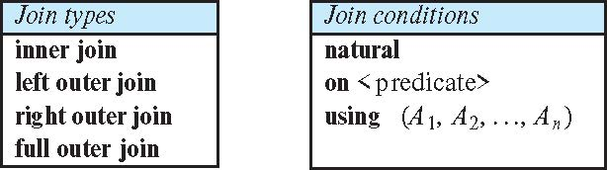
Joined Types and Conditions
Join operations take two relations and return as a result another relation.
These additional operations are typically used as subquery expressions in the from clause
Join condition – defines which tuples in the two relations match.
Join type – defines how tuples in each relation that do not match any tuple in the other relation (based on the join condition) are treated.
Notes:
To distinguish normal joins from outer joins, normal joins are called inner joins in SQL. A join clause can thus specify inner join instead of outer join to specify that a normal join is to be used. The keyword inner is, however, optional. The default join type, when the join clause is used without the outer prefix, is the inner join. Thus,
select *
from student join takes using (ID);
is equivalent to:
select *
from student inner join takes using (ID);
Similarly, natural join is equivalent to natural inner join. Figure 4.7 shows a full list of the various types of join that we have discussed. As can be seen from the figure, any form of join (inner, left outer, right outer, or full outer) can be combined with any join condition (natural, using, or on).

Slide 19
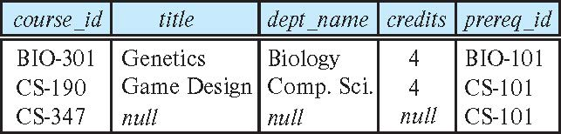
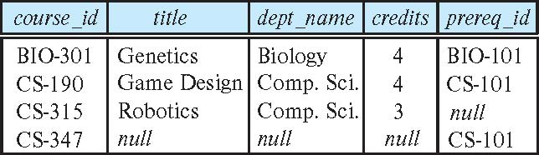
Joined Relations – Examples
course natural right outer join prereq
course full outer join prereq using (course_id)

Slide 20
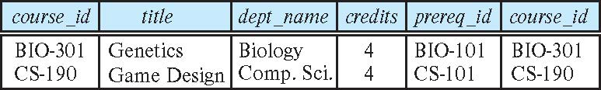
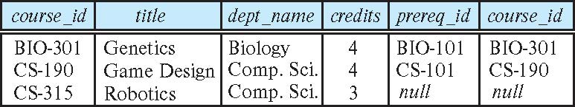
Joined Relations – Examples
course inner join prereq on course.course_id = prereq.course_id
What is the difference between the above, and a natural join?
course left outer join prereq on course.course_id = prereq.course_id

Slide 21
Joined Relations – Examples
course natural right outer join prereq
course full outer join prereq using (course_id)

Slide 22
End

